Slide 1
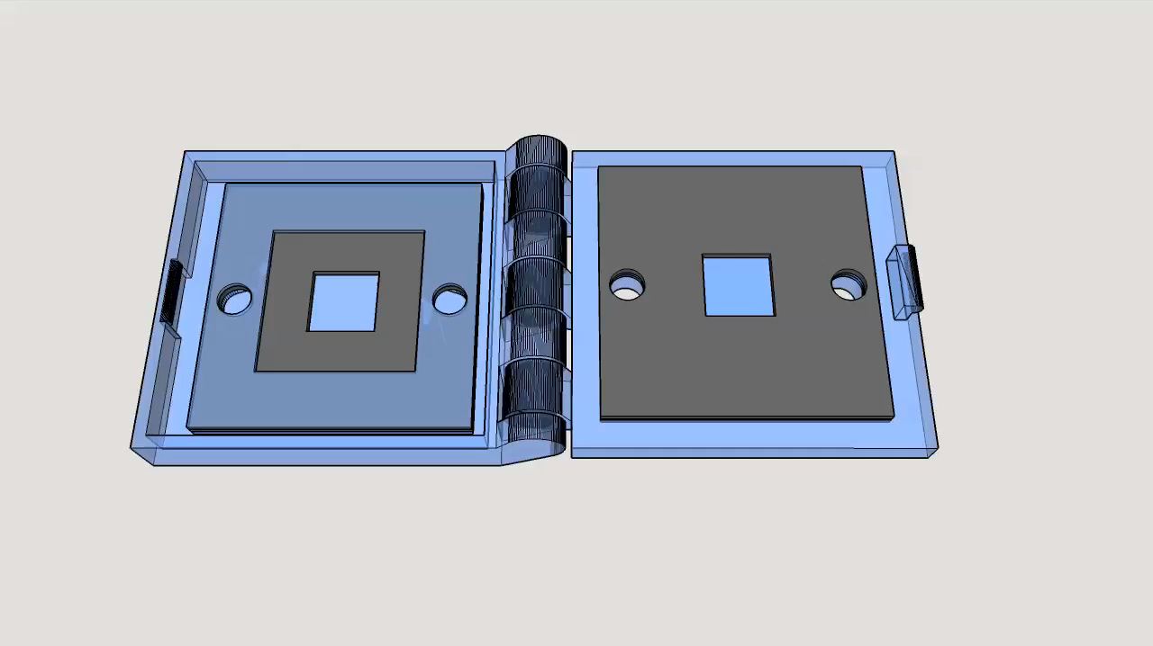
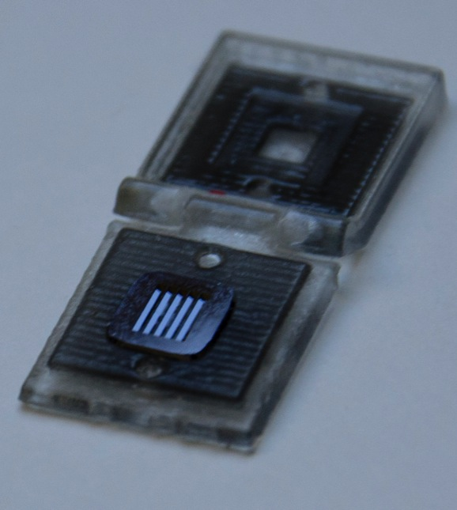
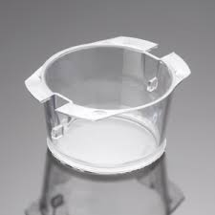
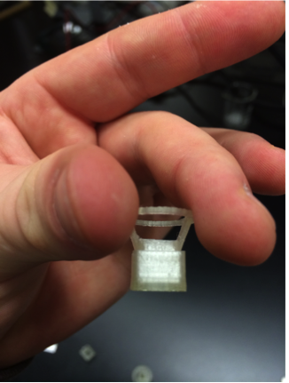
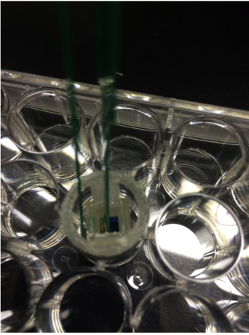
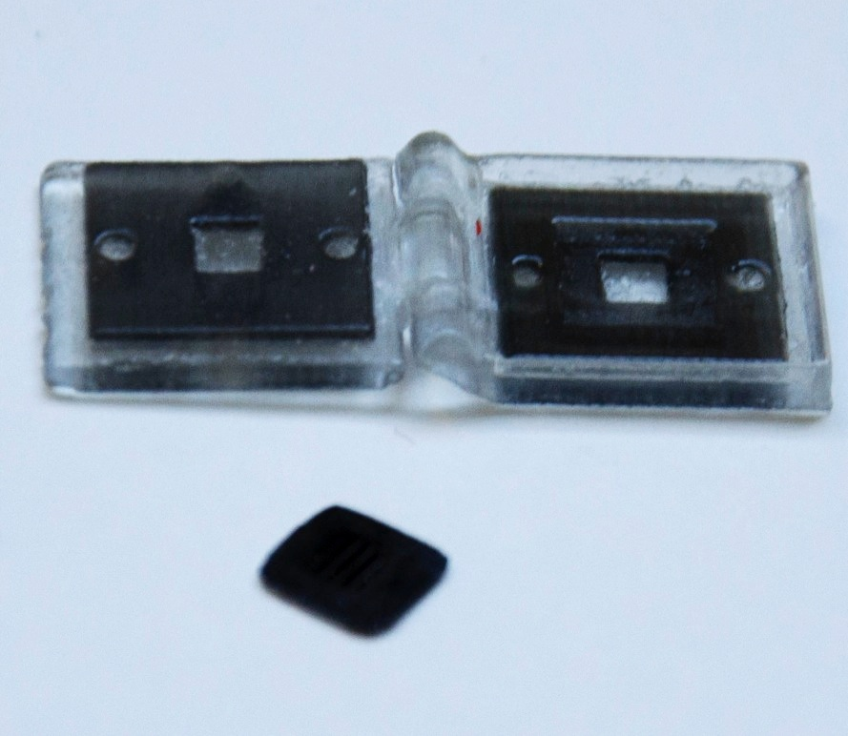
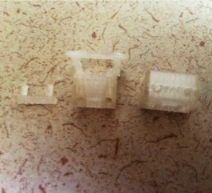
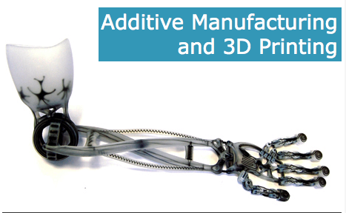
Towards a 3D-printed membrane platform for cell culture
thanks to Greg Madejski for the animation

Slide 2
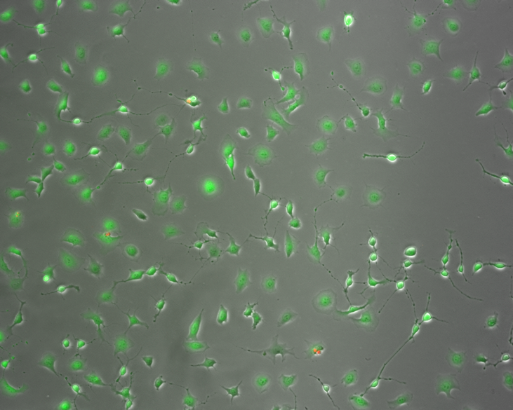
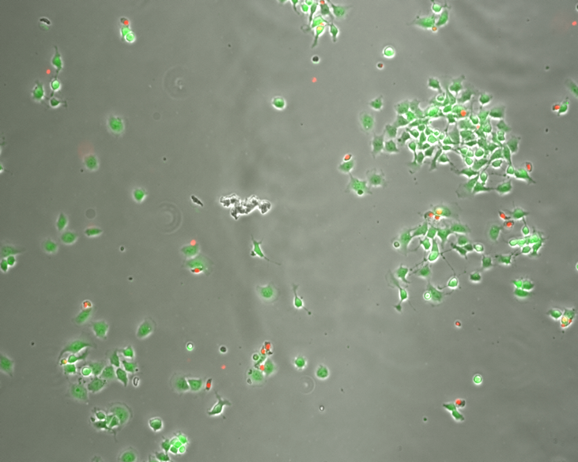
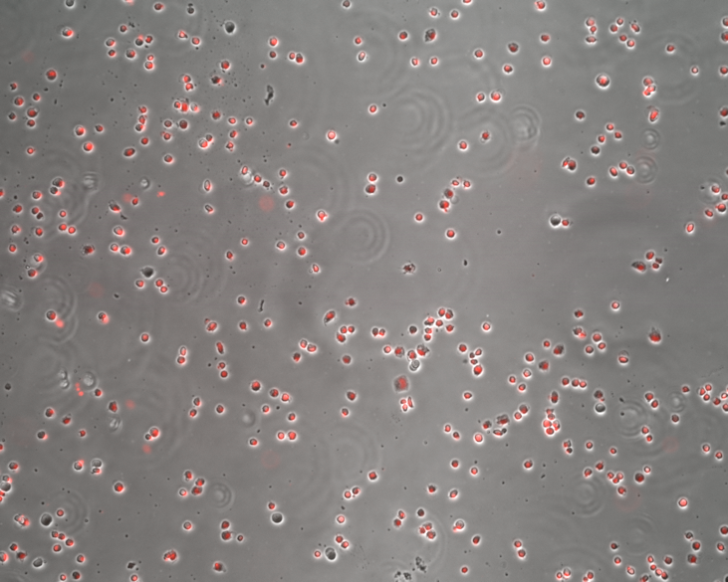
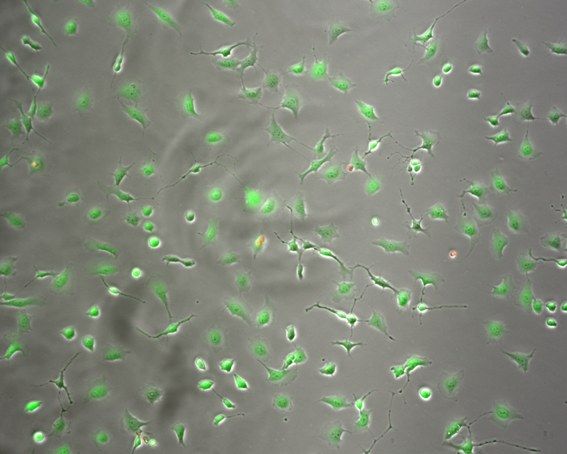
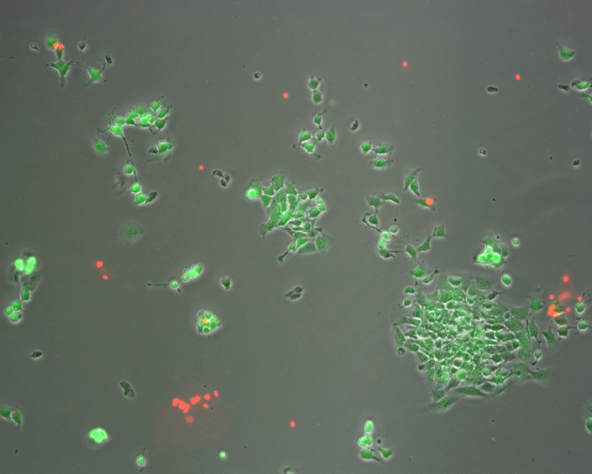
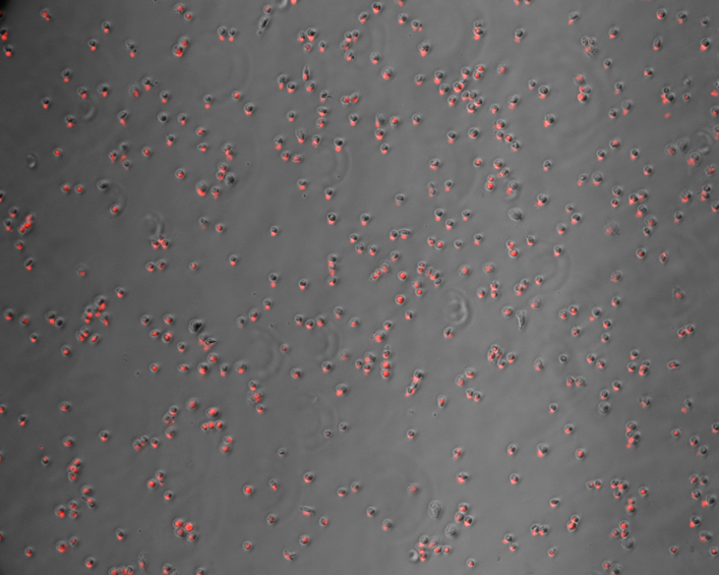
3D printed materials effect on cell growth and health
Control
“VeroClear™”
“TangoBlack ™”
Live (calcein-AM)
Dead (propidium iodide)

Slide 3
Live/Dead assay (calcein-AM / ethidium homodimer)
Anomalous increase in cell number followed by total death in the presence of TangoBlack ™
VeroClear ™ causes clumping and some cell death combined with unusual morphology, clustering
Leachate? Incomplete photopolymerisation? …

